Slide 1
Burma Link
The Empowered Life and Leadership Skills training – PICTURES AND QUOTES

Slide 2
DAY 1

Slide 3
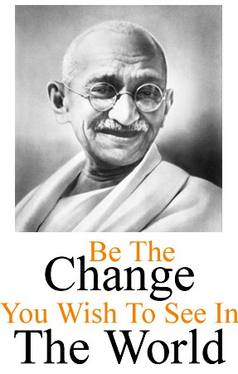

Slide 4
Objectives of the ELLS Training
1. Understand the basics of empowerment
2. Value yourself and others as unique individuals; feel more confident and more comfortable with yourself
3. Understand why honesty and courage and responsible citizenship are essential qualities of empowered people
4. Know the value of being an attentive and respectful listener
5. Know the value of being an honest and clear communicator
6. Know how to get things done, honour your commitments, and solve problems.

Slide 5
Highly educated
Polite
Authentic
Responsible
Easy-going
Honouring commitments
Good communicator
Obedient
Getting things done
Honest
Courageous
Talkative
Good-looking
Avoiding conflict
Notes:
,,,

Slide 6
Authenticity

Slide 7
Honouring commitments

Slide 8
Empowered person is authentic and comfortable with oneself, is honest and courageous, and is a responsible citizen who communicates well with other people, honours their commitments, and gets things done!

Slide 9
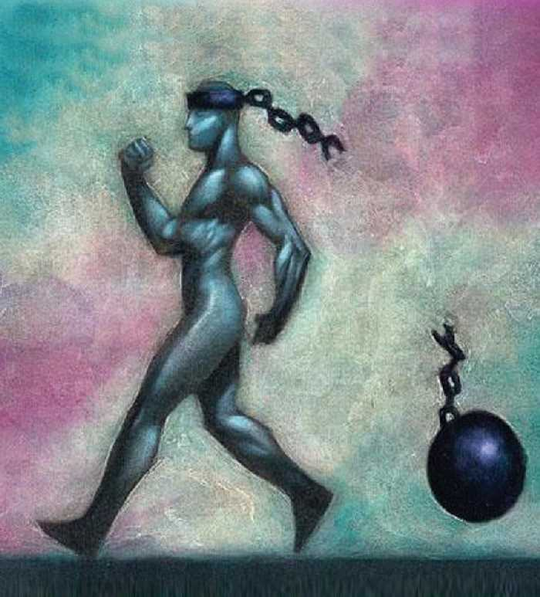

Slide 10
“Courage is the first of human qualities because it is the quality which guarantees the others” - Aristotle

Slide 11
What is honesty?

Slide 12
Honesty means being open, trustworthy, and truthful. When people are honest they can be relied on not to lie, steel, or cheat. Honesty is telling the truth. It is admitting mistakes even when you know someone might be angry or disappointed. Being honest means that you don’t pretend to be something you are not. With honesty, you can trust things to be as they are.

Slide 13
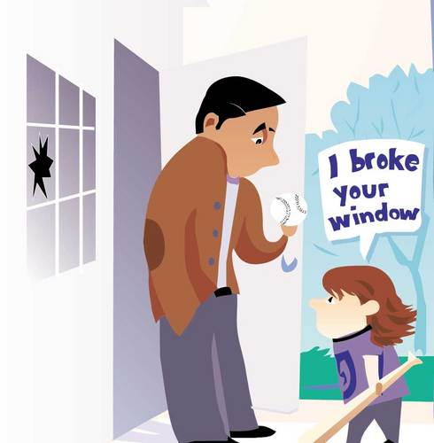
When is it most difficult to be honest?

Slide 14
Why is honesty important?

Slide 15
Honesty is important because it builds trust. When people lie, or cover up mistakes, others can’t trust them. When people aren’t honest with themselves, they pretend that something doesn’t matter when it does or they exaggerate to impress others. When you are honest with yourself, you accept yourself the way you are. When you are honest, others can believe you. When you are honest, you are more likely to become a person of integrity.

Slide 16
What is integrity?

Slide 17
When you are a person of integrity you are honest and fair. You live by your values and stand up for what you believe is right. It is being honest and sincere with others and yourself. You are a person of integrity when your actions and words match; you keep your word. You don’t fool yourself into doing what you know is wrong. You fill your life and your mind with things that help you to live a good, clean life

Slide 18
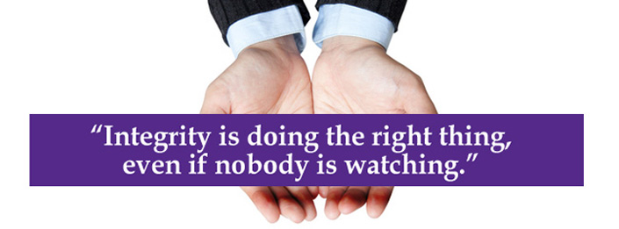

Slide 19
Effects of honesty and courage – true/false
1. Honesty builds trust
2. Honesty creates unnecessary conflict
3. We begin to develop integrity
4. We begin to develop a wider self-acceptance
and more self-respect
5. We lose potential friends
6. When we are being open and honest about who we are,
some people will reject us, but our true friends will stay
by our side. We know who our friends are and can
develop more meaningful friendships and relationships

Slide 20
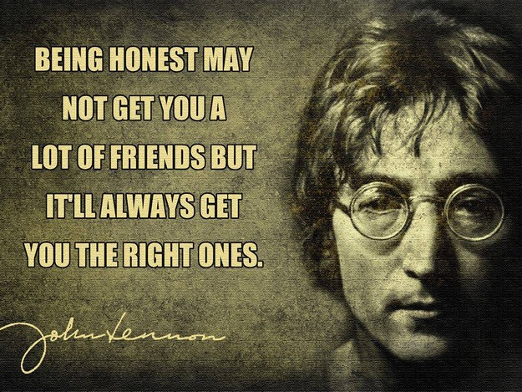

Slide 21
Effects of honesty and courage – true/false
7. We will attract other honest and courageous people around
us. People who manipulate others and play games with
people do not want to be around honest people.
8. We feel stressed.
9. We have less stress. We don’t need to try to remember what
we have lied about when we know we have told the truth.
Our conscience is clear and we feel peaceful.
10. As we become honest and courageous, we are likely to
become good people. A good person is not the same thing
as a nice person.

Slide 22
Courage
One isn't necessarily born with courage, but one is born with potential. Without courage, we cannot practice any other virtue with consistency. We can't be kind, true, merciful, generous or honest. — Maya Angelou

Slide 23
How to develop courage?
1. Face your fears, do what you are afraid of! The Golden road to self-development is stepping out of your comfort zone! It also helps you grow and make you happier
2. Take risks (but use common sense - there’s a difference between a risk and a dangerous idea)
3. Try out new things and take on new challenges
4. Learn a new skill
5. Be spontaneous and open for new experiences and ideas
6. Do not avoid something just because you are nervous, anxious or afraid –
just do it!
7. Be honest even when it’s difficult
8. Stand up for yourself and others

Slide 24
DAY 2

Slide 25
“Getting in touch with your true self must be your first priority.” - Tom Hopkins

Slide 27
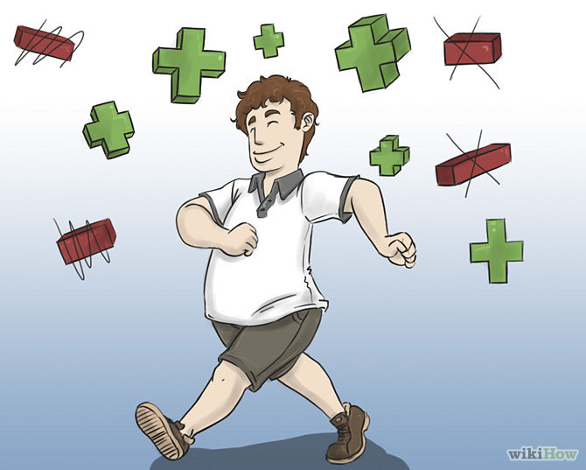

Slide 28
Being comfortable with who we are
Be honest to yourself and others. It helps us develop a wider self-acceptance and increases our self-respect, and thus helps us to be more comfortable with ourselves.
Treat yourself with love, respect and acceptance. This is important! Take good care of yourself and pay yourself daily compliments. Be your own best friend.

Slide 29
Being comfortable with who we are
Another simple way to be more comfortable with yourself is to find your natural talents and develop them. Your natural gifts are the things you do effortlessly and may include working with numbers or the ability to draft, draw, organize, sing, listen, write clearly or lead.
One of the most significant ways is to be able to talk about who we are and what is important to us.

Slide 30
What is identity?

Slide 31
Identity is who you are. It can include things like interests or hobbies, family, religion, character traits, personality, ethnicity, and communities we belong to.

Slide 32
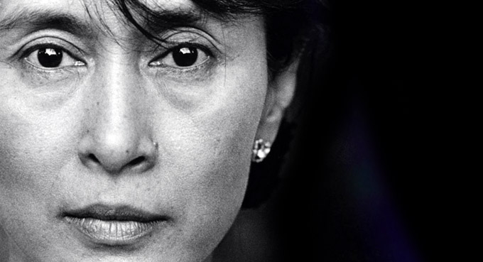

Slide 33
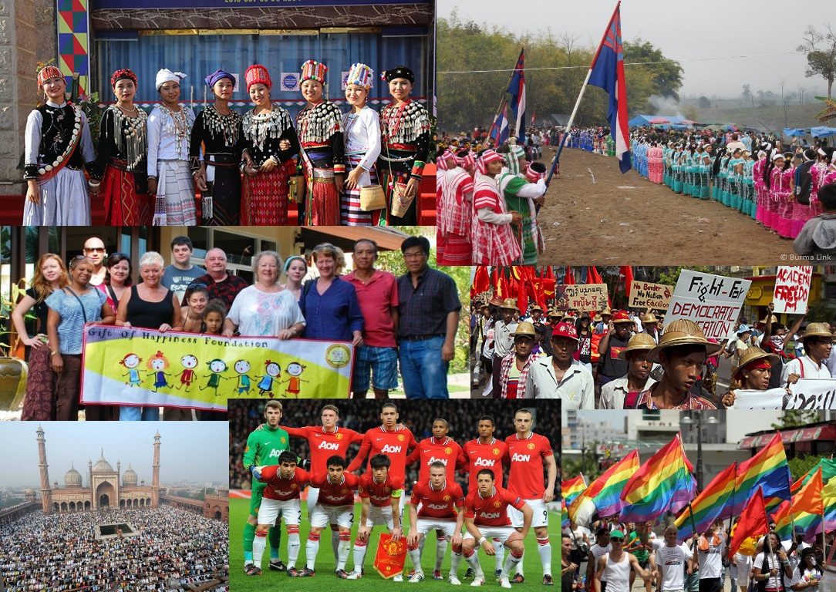

Slide 34
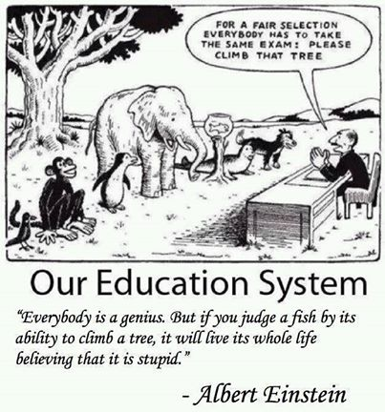

Slide 35
Conclusion
Knowing your identity helps you to be more comfortable with yourself and influence your community in a positive way.
Understanding that people have different identities helps us appreciate the differences that are needed in forming a successful community. Working with those differences and understanding diversity helps us solve and avoid problems and conflict.
When diverse individuals and groups join together, they can form stronger communities and reach common goals.

Slide 36
What is responsibility?

Slide 37
Responsibility means being accountable for your behaviour (which means answering for your actions); being dependable and trustworthy.
Responsibility is a core value for living an honourable life.

Slide 38
What is citizenship?

Slide 39
Active citizens take part in the development of their community. They accept their rights and responsibilities as part of the community. They promote social justice, equality, and respect for human rights. Active citizens work together to achieve shared goals and to build better communities.

Slide 41
"There are two types of laws: just and unjust. Every individual in a society has a responsibility to obey just laws and, even more importantly, to disobey and resist unjust laws." – Martin Luther King, Jr.

Slide 42
Responsible citizenship is about individuals who realize their obligations to take actions that ensure their community is healthy, safe and secure. A responsible citizen participates in their community to promote personal and public good. It often takes moral courage to be a responsible citizen.

Slide 43
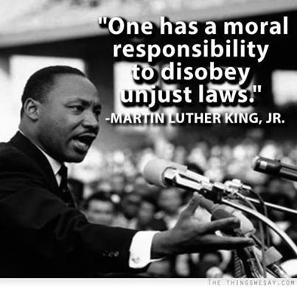

Slide 46
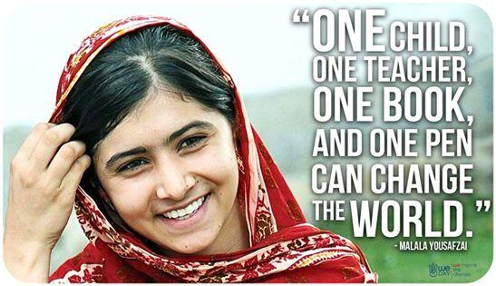

Slide 47
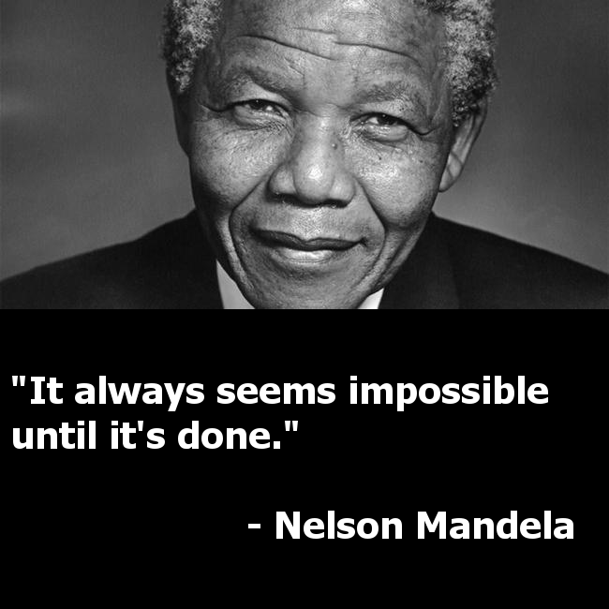

Slide 49
DAY 3

Slide 50
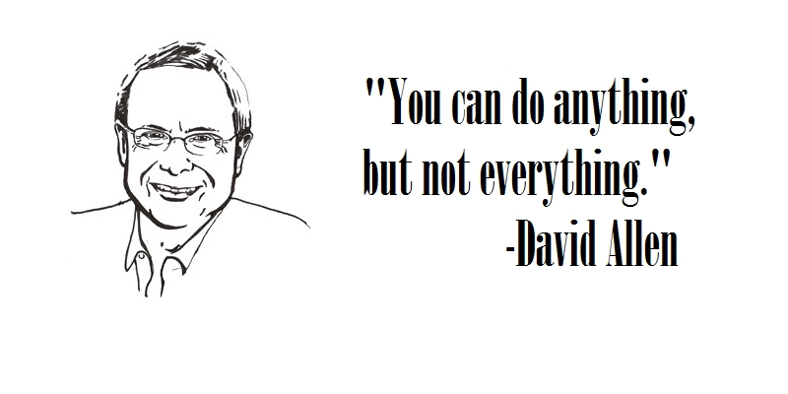

Slide 51
Good speaking skills require being open, honest, and clear. While we may think that we are clear communicators, others still may have trouble understanding us. Be humble and patient.

Slide 52
Good listener
Bad listener
Looks at the person talking
Attends to what they are saying
Indicates to the other person they are listening (e.g. nodding, saying yes)
Asks for clarification if they don’t understand
Clarifies or summarises to the person what they just said
Focuses on the speaker’s thoughts, not their own thoughts!
Put themselves into the speaker’s position
IS PRESENT
Looks away
Doesn’t indicate that they are listening
Expression on their face doesn’t change
Is distracted (e.g. looks at the time or other people)
Changes the subject

Slide 53
Good listening skills require really wanting to listen and taking responsibility for understanding the speaker. The speaker cannot read your mind so if you don’t understand you need to make that clear.
You don’t need to agree with the speaker but you should appreciate that everyone is different and is entitled to their feelings and own opinion. Focus on the speaker’s thoughts, not your own. Focus even more if you disagree with the speaker.

Slide 54
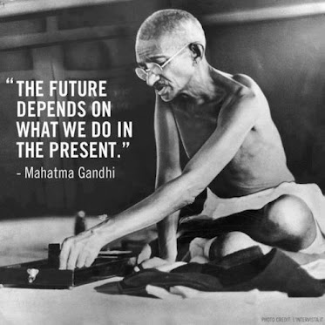

Slide 55
Breaking down tasks and getting things done

Slide 56
Honouring commitments

Slide 57
Honoring your commitments means:
Plan your time effectively with to do lists, and follow your plans.
Always keep your word; do as you say and do as you plan (but be flexible - sometimes unexpected things happen and we need to re-plan)
Give each task your full attention and do your best

Slide 58
Planning and problem-solving
Define the problem
Brainstorm solutions for the problem
Evaluate the different solution alternatives
Decide on the best solution
Plan steps to be taken
Implement your plan
Review

Slide 60
Empowered people communicate openly, honesty and clearly, and take the responsibility of being good listeners.
Empowered people understand that leaving issues unresolved will only lead to more problems in the future.
Empowered people have the reputation for getting things done. They choose their commitments carefully and say “no” if they don’t have the resources to follow through with a project or task.
Empowered people do not avoid or put off work and commitments. No matter how big the challenge, they will break down the project to manageable tasks that can be tackled one at a time.
Empowered people are doers. They do not make excuses or blame other people. Empowered people make commitments and honour them.

Slide 61
